Slide 1
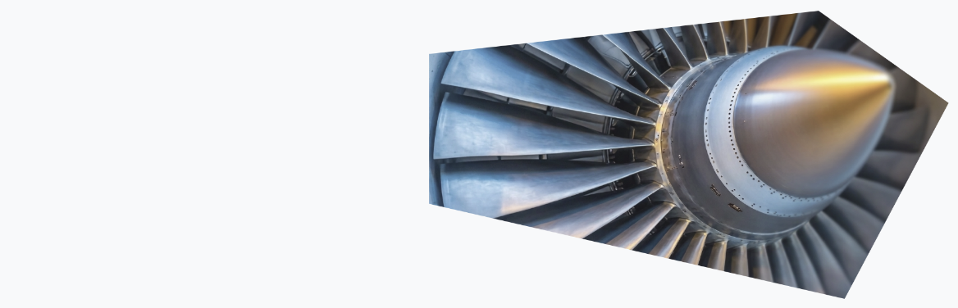

Visual AI MRO
www.aiVisualMRO.com

Slide 2
What is Visual AI MRO ?
Visual AI MRO is an advanced AI solution designed for visual inspection and maintenance, monitor repair, and other operations. AI models taylored to your needs, automatically detect defects like scratches, dents, corrosion, and more with 87%-99% accuracy.
How does the defect detection work ?
Our AI models analyze images from any camera, or boroscope to automatically identify and classify defects. The system is trained on your specific images, ensuring maximum accuracy for your use case.
Can it run locally ?
Yes! these AI models can be trained on your own images and run locally on your infrastructure for maximum privacy and security. Your data never leaves your system, unless you want it to. This is perfect for Aerospace and defence sector where most of the data analysis and AI models need to run privately

Slide 3
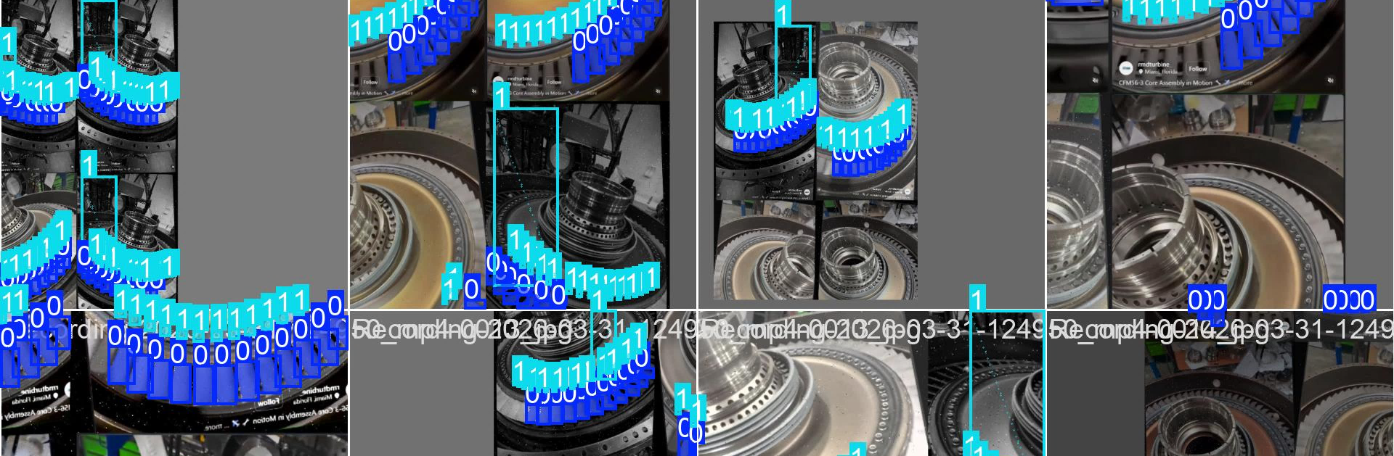
AI Usecases

Slide 4
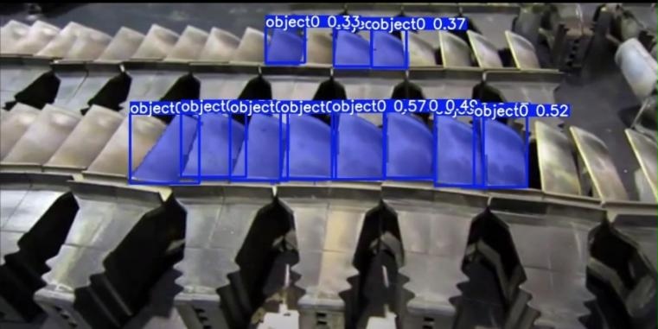
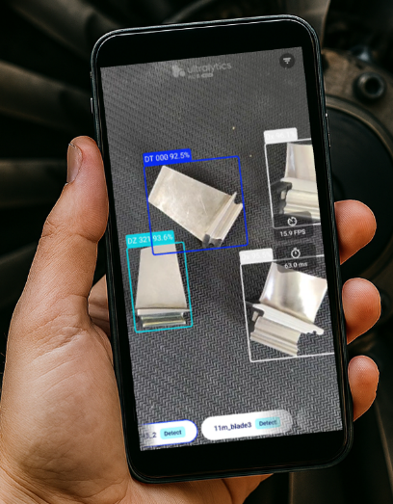
Usecase 1 : Part-Detect
Industrial turbine blades inspection :
The AI detects the blades on the inspection table, extracts the objects (blades), and calculates the % of coating left before the parts go for repair, stripping and re-coating.
The report is auto-generated after inspection finishes. – saving close to 84% of inspection time.
Link : see video
Visual Inspection compressor blades :
The AI inside the android app, detects the compressor blades and is looking for scratches, dents, smudges, foreign material. Then automated report is generated.
Link : see video
Link : More info

Slide 5
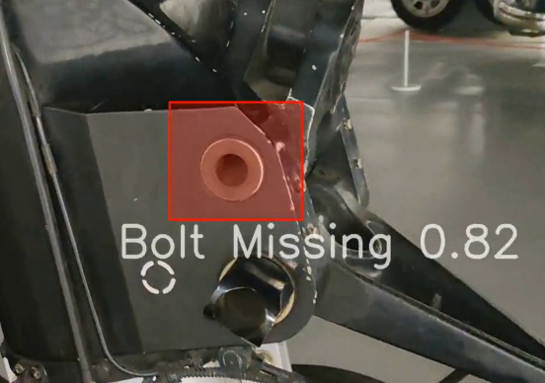
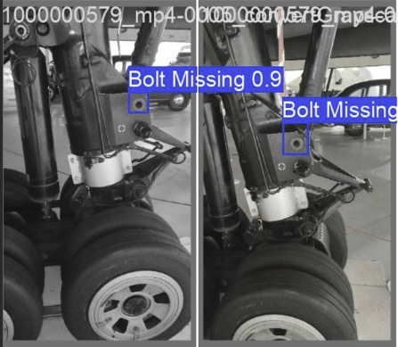
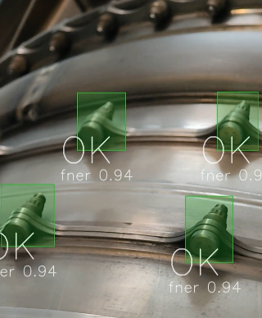
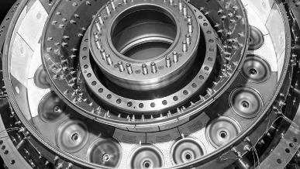
Usecase 2 : Missing or incorrect parts
Quick visual inspection missing parts :
AI Visual MRO can detect missing or incorrect bolts on a final assembly. Even if this is low probability it has a big impact, almost critical (see the case of Boeing door panel). This will help as a quick check before final assembly, or later for data analytics while in service.
Link : Missing bolt on landing gear: see video
Link : Combustor outer case inspection: see video
Link : More info

Slide 6
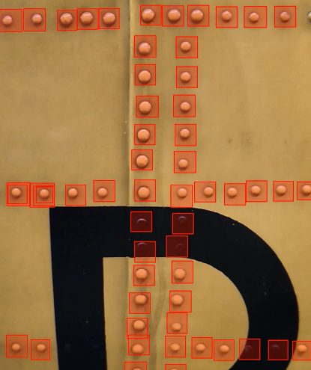
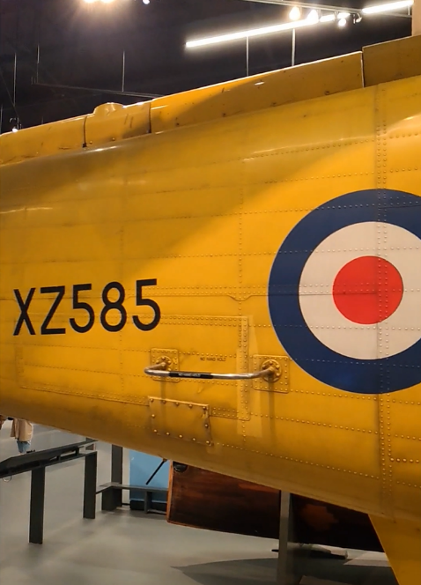
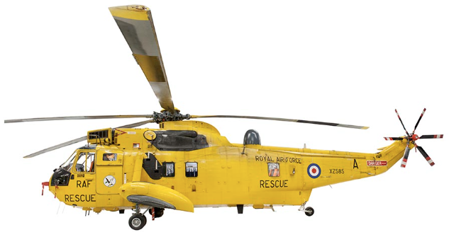
Usecase 3 : Panel inspection
Aircraft skin rivets inspection :
Example of AI detecting the rivets and studs on the aircraft skin, it not only detects the presence but also the state of them: corrosion, missing paint, fob, and others.
It also allocates a unique ID to each of them to be able to be tracked in service.
After the visual inspection is completed the report is autogenerated and uploaded to SAP automatically.
This saves more then 90% of inspection time. Freeing up time for technical staff to focus on other quality operations.
Link : see video
Link : More info

Slide 7
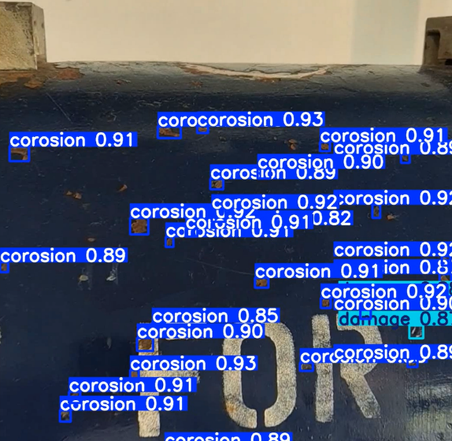
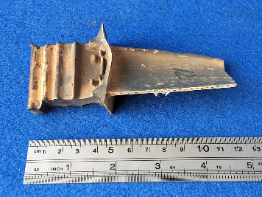
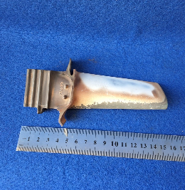
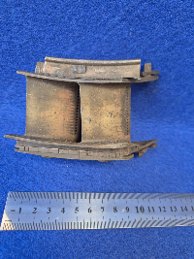
Usecase 4 : Corrosion detection & logging
Corrosion detection:
Example of AI detecting corrosion and/or other defects on an aero surface, it logs the size and location of the corrosion found. It can also Auto-reject the part depending on the company rules.
This can be used for a pre-inspection system (to check whatever the part is even worth inspecting and going through he system) or auto-rejecting it.
Link : see video
Other examples the AI can pickup

Slide 8
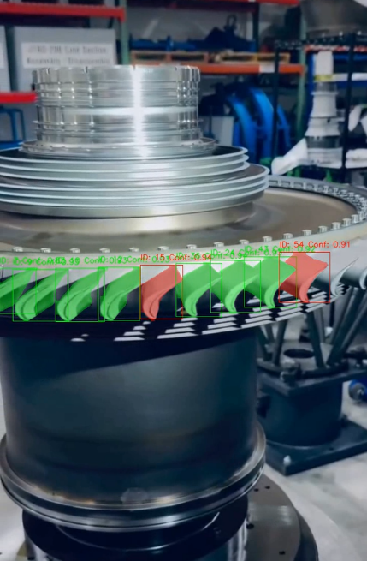
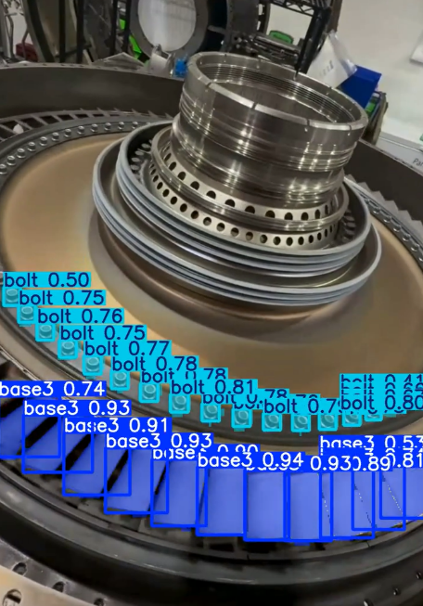
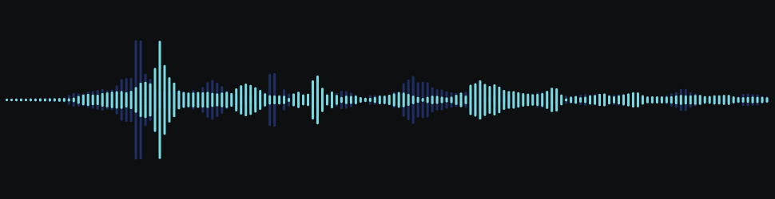

Usecase 5 : AI Inspection Assistant
CFM56 – Rotor inspection :
Example of AI assisting the visual inspection of a CFM56 rotor blades. It detects any defects like dents, scratches on the rotor blades, it extracts the blades and gives the inspector a visual feedback.
It also picks-up the audio of the inspector and using Wisper AI, it transcribes the visual inspection audio into the report and summarizes
Link : see video

Slide 9

AI Capability & Deployment

Slide 10
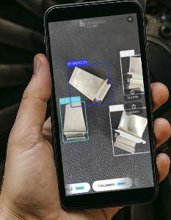
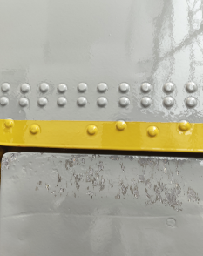
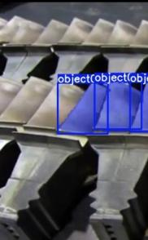
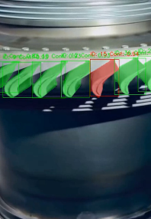
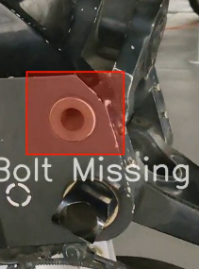
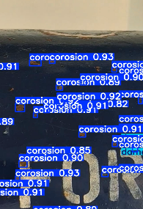
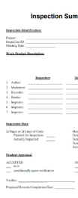
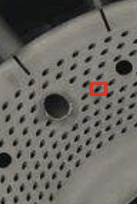
AI Capability - May 2026
Part detect, from big parts all the way to small parts (1cm) . Can run locally on phone.
Level: Easy
Rivets, bolts, missing paint, scratches on skin, panel inspection
Level: Easy
Turbine blades on a table (pre-inspect) for auto reject- cost saving.
Level : Easy
Models investigated:
Vision:
Ultralytics
YOLO V11-V26
Yolo Seg
Yolo Detect
Yolo Pose
Audio:
Wisper AI
Report:
Lllama 3.2 ,4
Qwen
Distance Estimation:
Depth Anything v2.0
And many others ….
Blades : irregular changing shapes, need big-data set for high confidence.
Can run locally – phone , needs constant light
Level: Medium-Hard
Missing bolt – easy
Wrong Bolt – medium
Loose Bolt – md-hard
Ai needs quality dataset to be trained on in order to detect
Level: Easy- Medium
Defects : Corrosion, dents, scratches
Can run locally, patience is required (more frames)
Easy: same plane inspection, constant light
Level: Medium
Summary building report with LLM
Local - requires patience (medium)
Cloud - Easy
Level: Easy - Medium
Cooling holes: small irregular holes at various angles.
AI model cannot run locally (phone), needs GPU compute
Level: Very Hard/ Expensive Compute
AI assisted Audio transcribing for reporting purposes
Level: Easy

Slide 11
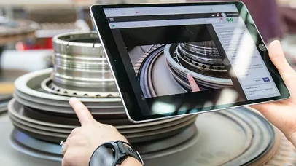
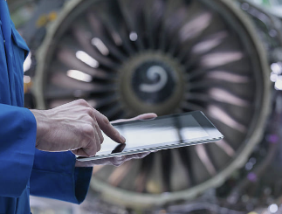
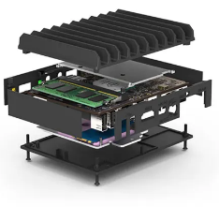

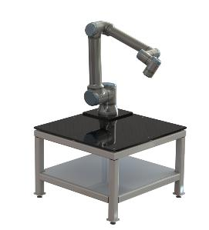
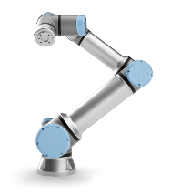
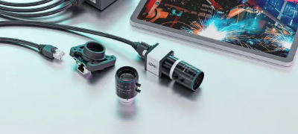
AI Deployment
Local detection / Assistant :
Deployment on edge device ( phone , tablet) is possible for easy to medium models (nano – medium).
Local on table AI :
Local Deployment on table (inspection table) AI for more powerful models ( Medium – Large) is also possible. Gives you flexibility to run more complex visual inspection procedures.
mini local compute
Automation integration:
Integration with local co-bot for an fully automated or semi-automated solution is possible.
Camera agnostic:
AI Visual MRO tools work with any fix camera, body cam, boroscope, mobile phone, tablet, webcam.

Slide 12

Cost / Return

Slide 13
AI Cost
Initial discussion / Onsite Demo : Free
Initial Model – Deployment : 4 weeks: $4.000 - $5.000
On-site deployment & training
Private Dataset (onsite photos, onsite training)
Manual vision automation
Basic documentation
2 x Onsite support sessions
Production ready solution : 4-6 weeks: $10.000 - $30.000
All Basic Package features
2x prototype custom fixture design
Custom light-fixture design
Device (Camera or Android )
Integration with SAP or ERP systems
Repeatability & Reproducibility (Gage R&R)
On-site testing support
Basic Analytics dashboard
Every company performs visual inspection differently. AIVisualMRO begins with a non-intrusive observation phase to understand your current workflow, tools, constraints, and quality criteria. Requirements are gathered collaboratively to ensure the platform fits seamlessly into your existing operations.

Slide 14
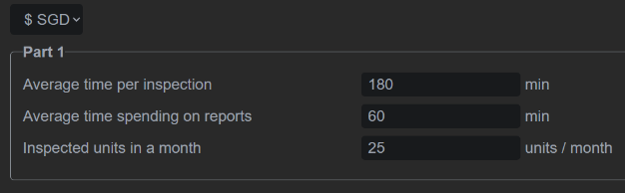
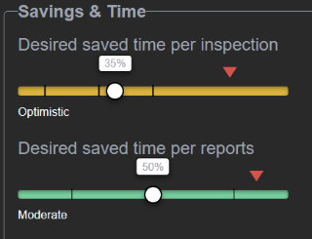
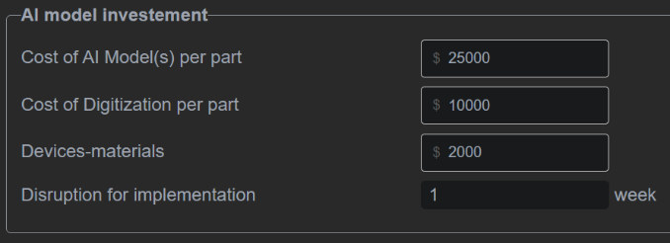
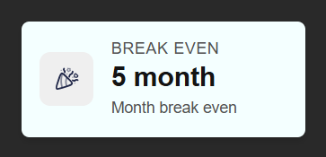
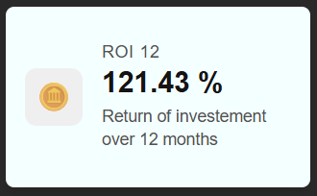
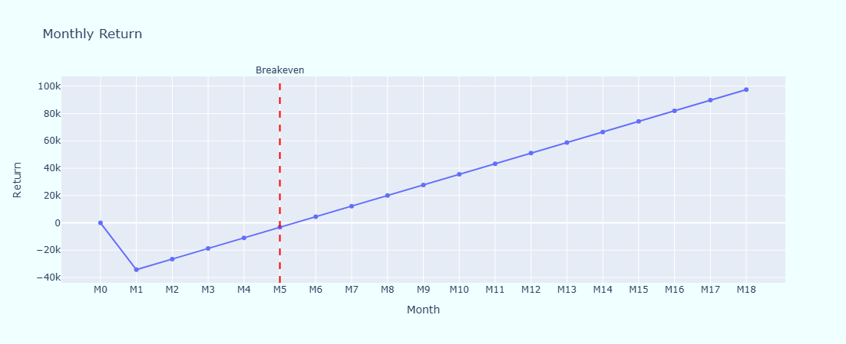
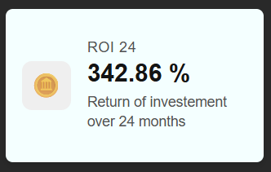
Return
Link: Play with the AI return on investment (ROI) calculator: link here

Slide 15
Thank You
www.aiVisualMRO.com
Contact the Founder :
Julian.Marinescu@outlook.com
WhatsApp: +44 7535 739690

